Slide 1



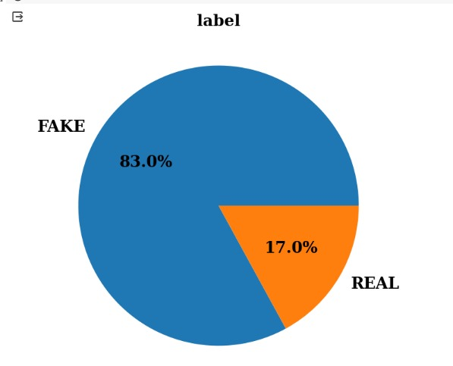
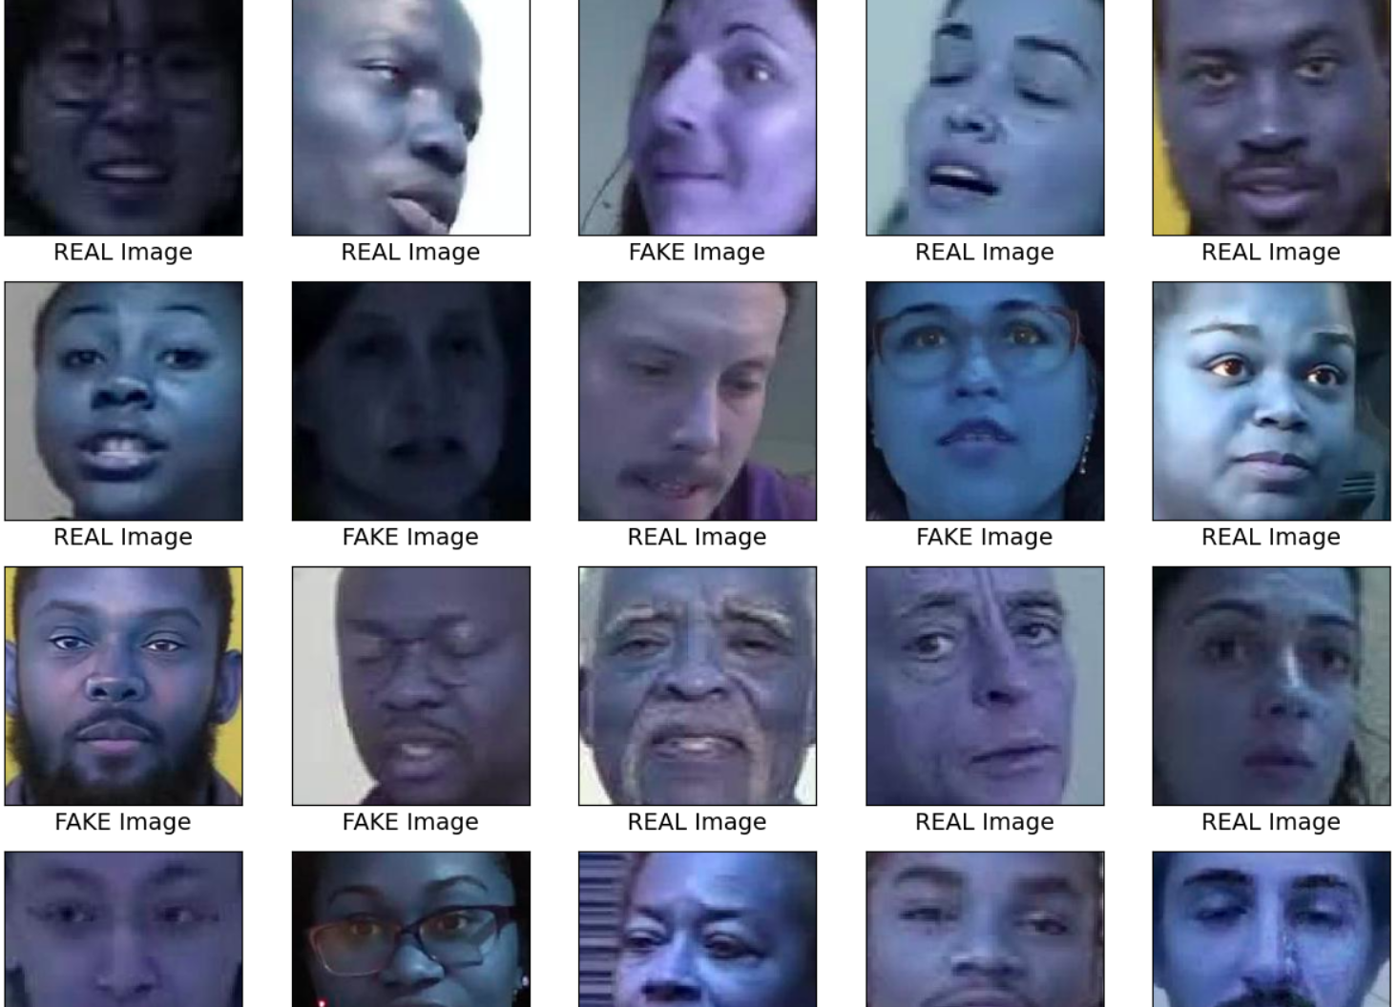
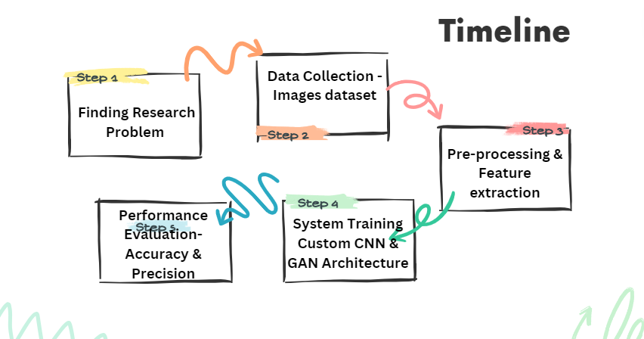
Techniques Utilized
Improving Deepfake Detection Using Deep Learning
School of Computer Science Engineering and Technology
Bennett University, India
Introduction
Our project “Improving Deepfake Detection using Deep Learning" aims to address the growing concern of disinformation and manipulation through the creation of realistic yet fake content.
With the widespread use of social media and the ease of producing deep fakes, the project seeks to develop a robust system capable of distinguishing between authentic and manipulated content.
Python(Pandas, NumPy)
Matplotlib, Pandas
TensorFlow/PyTorch
CNN,
GAN (Bicyclic & Deep)
AI/ML
Problem Statement​
The proliferation of deepfake technology poses a significant threat to the authenticity of digital media content, fueling the dissemination of misinformation and manipulation. Despite advancements in deep learning techniques, the rapid evolution of deepfake generation methods, including the utilization of advanced Generative Adversarial Networks (GANs) such as Bicyclic GAN and Deep GAN, presents a formidable challenge in effectively detecting and combating fabricated content.
Our project leverages the capabilities of Python, Pandas, NumPy, Matplotlib, and TensorFlow/PyTorch to develop an advanced platform for image manipulation detection. It utilizes Python's versatility, Pandas and NumPy for data handling, Matplotlib for visualization, and TensorFlow/PyTorch for implementing Convolutional Neural Networks (CNNs) and Generative Adversarial Networks (GANs), including Bicyclic and Deep variants, for robust artificial intelligence and machine learning capabilities.
DATASET
Conclusion ​
Development of a state-of-the-art deepfake detection system using comparative analysis of two types of GAN ( Bicyclic GAN & Deep GAN) which is capable of accurately identifying manipulated multimedia content across diverse formats and platforms.
Validation of the proposed approach through extensive experimentation using benchmark datasets and real-world scenarios, demonstrating superior performance compared to existing detection methods.
Team Members
N Bala Yashaswini – E21CSEU0432
Manvi Tandon – E21CSEU0415
Naman Agarwal – E21CSEU0952

